Slide 1

SMART APPLIANCES
IN
SMART HOMES
AITHU SNEHITH EE16BTECH11041
MANITEJA EE16BTECH11018
ROSHNI PANDE EE16BTECH11032
SUMANTH EE16BTECH11009

Slide 2
AIM
Procuring current and voltage values across an appliance at a given time.
Cutting down excess power consumption. -Dimming circuit -turning off devices that are undesirably turned “ON”
Plotting real time graph of power used by an appliance.
Toggling on/off of an appliance by a hand-held device
Monitoring power consumption by appliances globally.

Slide 3
OVERVIEW

Slide 4
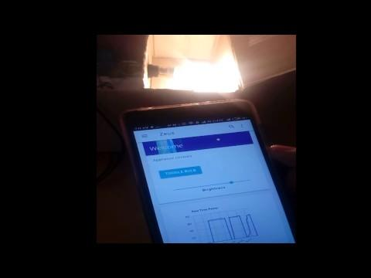

Slide 5
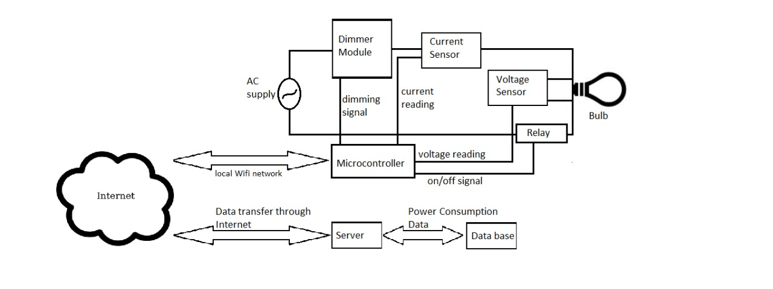
BLOCK DIAGRAM

Slide 6
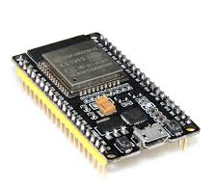
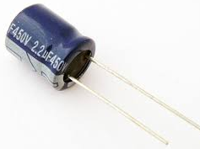
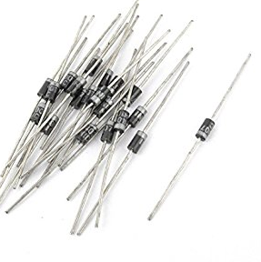
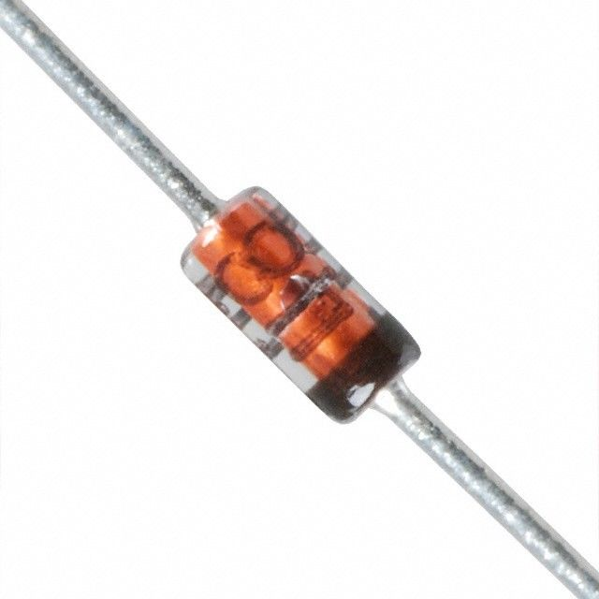
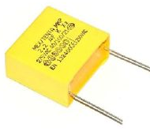
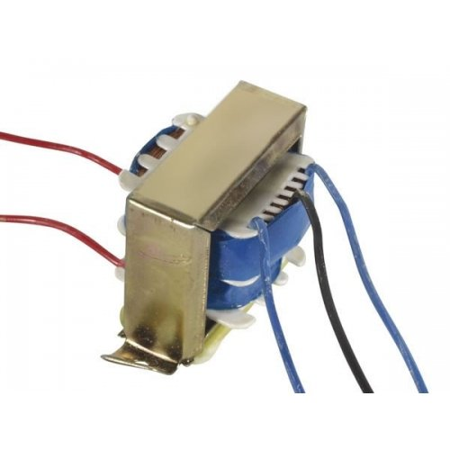
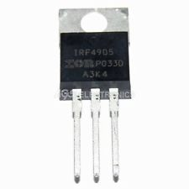
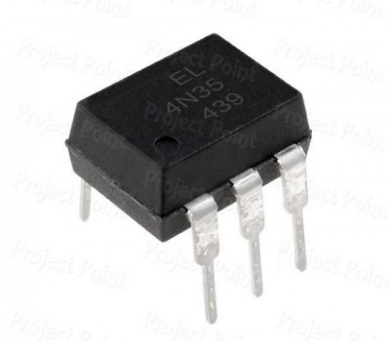
COMPONENTS
ESP32
IRF830
4N35

Slide 7
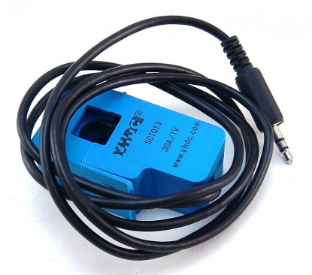
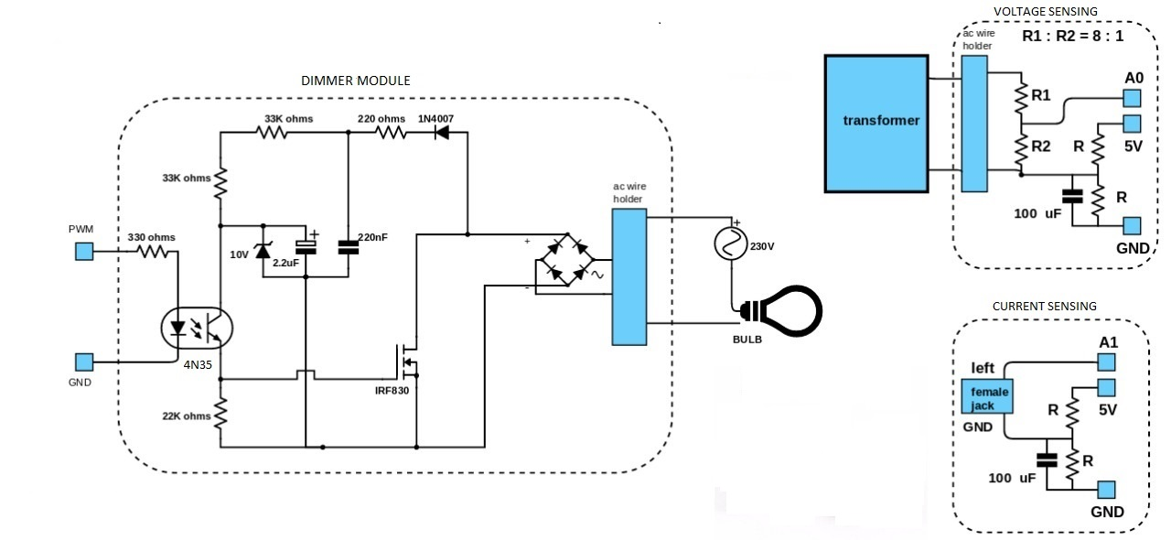
CURRENT SENSING
AC CURRENT CLAMP SENSOR

Slide 8
VOLTAGE SENSING

Slide 9
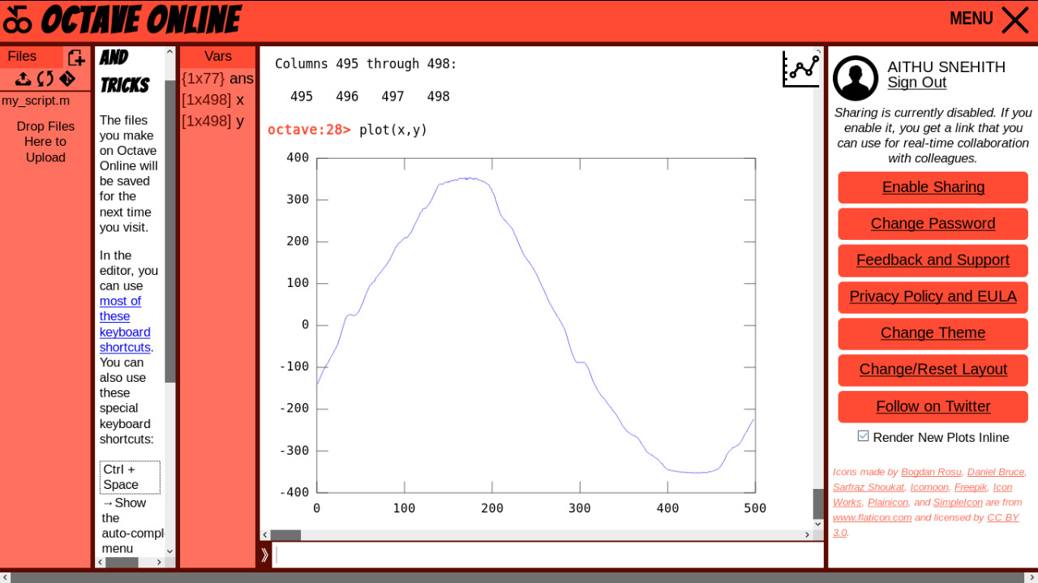

VOLTAGE SAMPLING
Sampling rate : 505 readings per cycle
Sampling rate : 1010 readings per cycle

Slide 10
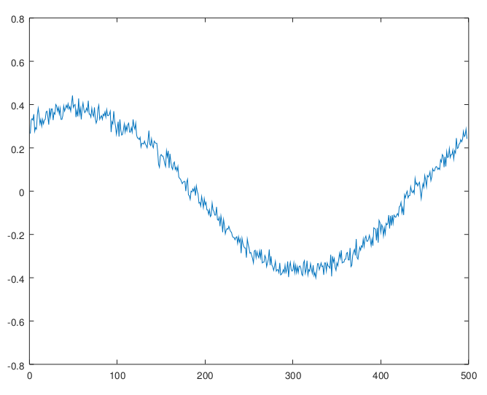
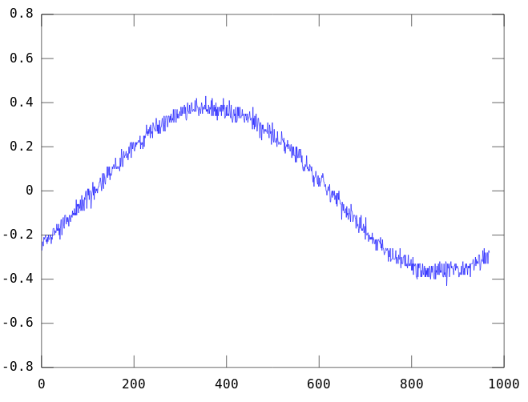
CURRENT SAMPLING
Sampling rate : 505 readings per cycle
Sampling rate : 1010 readings per cycle

Slide 11
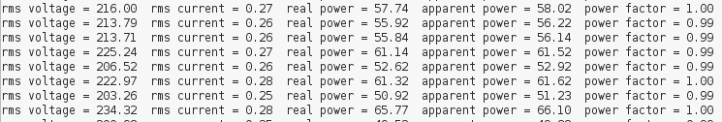
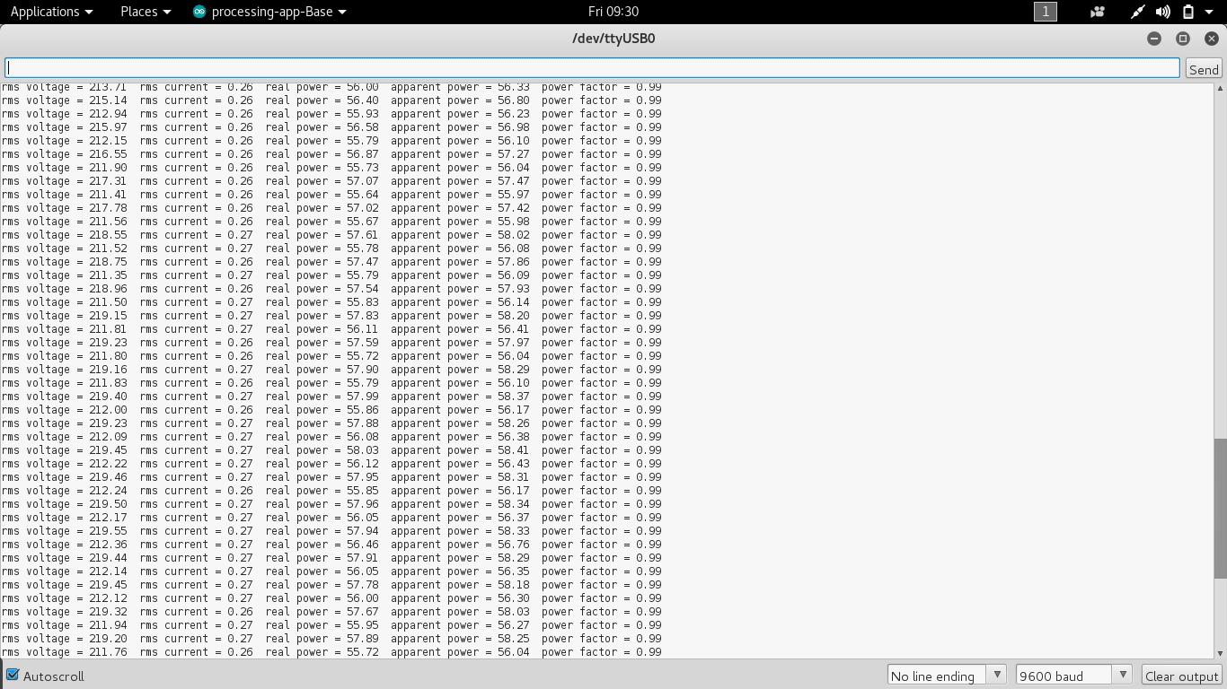
POWER ANALYSIS
Sampling rate : 505 readings per cycle
Sampling rate : 1010 readings per cycle

Slide 12
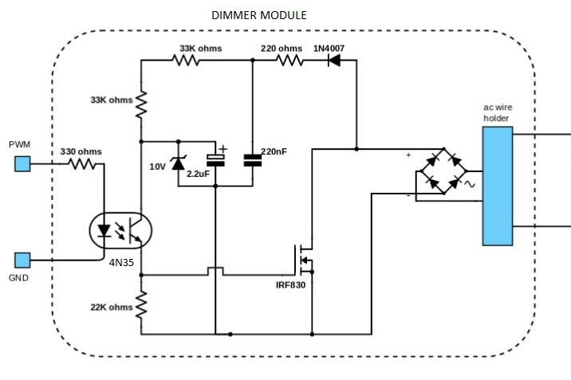
DIMMING CIRCUIT

Slide 13
SERVER INTERFACING
Web server
Network
Browser
(web client)
response
request
Computer (host)

Slide 14
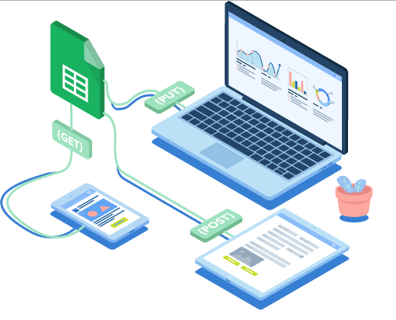

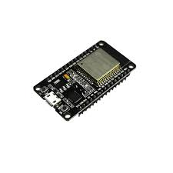
REAL TIME GRAPH USING GOOGLE SHEETS

Slide 15
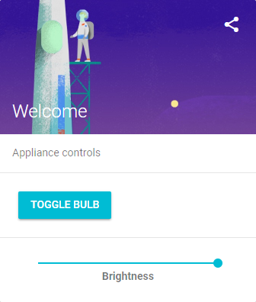
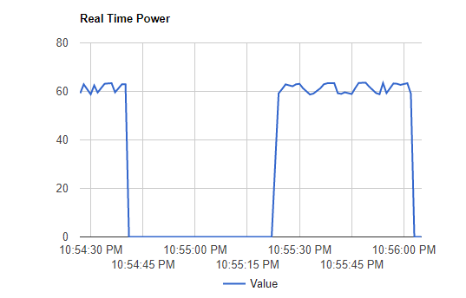
WEB APP
→www.teamzeus.tech

Slide 16
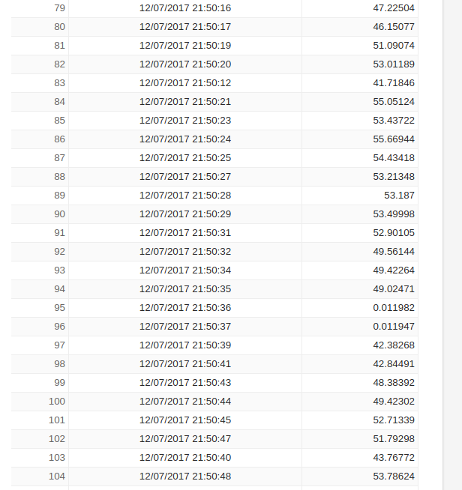
DATABASE

Slide 17
FUTURE SCOPE
Cost Alerts
Unusual “ON” timings of appliances
Detecting damaged appliances

Slide 18
REFERENCES
http://www.irf.com/product-info/datasheets/data/irf830.pdf
http://www.digikey.com/schemeit/project/
http://myelectronichome.altervista.org/blog/en/too-much-current-detector-absorbed-from-the-house-made-with-arduino-and-sct-013-020-or-013-030-sct/?doing_wp_cron=1509538957.9767251014709472656250
https://www.elprocus.com/opto-couplers-types-applications/
https://images.google.com/
THANK YOU

